Slide 1





AI Puzzle Escape
A CSP-based escape room game with four AI-generated puzzles, adaptive difficulty and a live AI status panel
FOUNDATION OF ARTIFICIAL INTELLIGENCE PROJECT
Mentor : Dr. Mrs. Theepa Karthisai
Team Members
DURKASRI - 240701132
GAYATHRI MOHANRAAJ - 240701143
Computer Science and Engineering
Rajalakshmi Engineering College
Batch: 2024 -2028
4 puzzles
AI generated
Notes:
Title slide. Team: Durkasri 240701132, Gayathri Mohanraaj 240701143.

Slide 2
Abstract
Why fixed puzzles get boring, and what we built
Most escape-room games use hand-written puzzles that are fixed, can be memorised and cannot adapt to the player.
AI Puzzle Escape treats every puzzle as a Constraint Satisfaction Problem (CSP). A backtracking search generates a valid answer first, then builds the clues (constraints) that lead to exactly that answer. Every playthrough is different.
The game has four stages: Number Lock, Object Arrangement, Logic Doors and Final Escape. An AI Status panel shows backtracks and constraint checks, and the difficulty changes automatically (MEDIUM to EASY) when the player struggles, with extra hints unlocked.
Keywords: CSP, backtracking, constraint checks, adaptive difficulty, logic puzzles, hint system
4
CSP
Puzzles
AI algorithm
lock, objects, doors, exit
+ backtracking
3
Adaptive
Constraint types
Difficulty
digits, order, truth
EASY / MEDIUM

Slide 3
Literature Survey
Foundations for the CSP engine, logic puzzles and adaptive difficulty
# | Reference | Contribution | Relevance to our work
1 | Russell & Norvig, Artificial Intelligence: A Modern Approach (CSP chapter) | Formalises CSPs, backtracking search and heuristics | Theoretical basis of our puzzle solver
2 | Mackworth (1977), Consistency in Networks of Relations, Artificial Intelligence 8(1) | Introduces constraint propagation and arc consistency | Pruning impossible values early
3 | Haralick & Elliott (1980), Increasing Tree Search Efficiency for CSPs, Artificial Intelligence 14(3) | Forward checking and fail-first ordering | Fewer backtracks and constraint checks
4 | Dechter (2003), Constraint Processing, Morgan Kaufmann | Complete treatment of constraint networks and search | Modelling order and digit constraints
5 | Smullyan (1978), What Is the Name of This Book? | Classic truth-teller / liar logic puzzles | Basis of the Logic Doors puzzle
6 | Hunicke (2005), The Case for Dynamic Difficulty Adjustment in Games, ACM ACE | Adjusts challenge to player performance | Difficulty drops to EASY when player struggles

Slide 4

System Architecture
Game interface, AI puzzle engine and adaptive modules
Game Controller
AI Services
Puzzle generators
CSP + backtracking
AI Status panel
backtracks, checks, log
Player
Game interface
Tabs: Number Lock, Objects, Doors, Final Escape
Inventory and hints
actions
metrics
Answer checker
validates player input
Difficulty adapter
struggle -> EASY
Inventory
stores collected clues
Hint manager
extra hints unlocked
Game flow Player action -> check answer -> update inventory -> log AI status -> adjust difficulty / hints -> next puzzle

Slide 5
CSP Engine: How a Puzzle is Generated
Variables, domains and constraints, then backtracking search
1
Define variables
digits of the lock, object positions, door exits
search tree
Start
2
Set domains
digits 0-9, positions 1-4, doors A/B/C
1
X
3
Generate answer + clues
random valid solution, then constraints that point to it
4
Backtrack + check
assign a value, test constraints, undo on dead end
X
2
ok
5
Verify uniqueness
clues must leave exactly one valid solution
dead end: undo, try next value
Example constraints
No digit repeated, 3rd digit > 1, Coin before Book, Key not next to Coin
6
Report to AI Status
backtracks and constraint checks are displayed

Slide 6





Modules
Four puzzle stages on top of four AI services
Number Lock
Objects
Logic Doors
Final Escape
Enter the 4-digit code
Clues: no repeats, parity, comparisons between digits
Place Book, Key, Coin, Card
Order and adjacency rules decide the positions
Pick the exit door
Only one door is the exit, exactly one sign tells the truth
Use collected items
Lock code and key position from earlier puzzles open the exit
CSP Generator
Adaptive Difficulty
Hint System
AI Status Panel
backtracking builds each puzzle
struggle detected: MEDIUM -> EASY
limited hints, +1 extra when struggling
backtracks, constraint checks, log

Slide 7
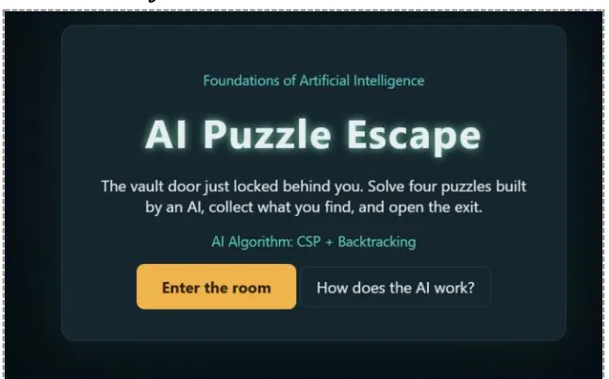
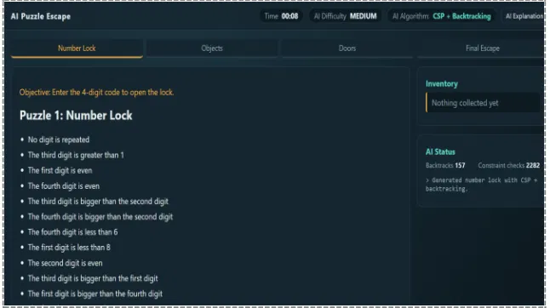
Output 1: Start Screen and Number Lock
Start screen
Shows the AI algorithm used (CSP + Backtracking)
"How does the AI work?" explains the method
"Enter the room" starts the timer
Puzzle 1: Number Lock
Clues: no repeated digit, even / greater-than rules
Status: 157 backtracks, 2282 constraint checks
Inventory and timer shown live

Slide 8
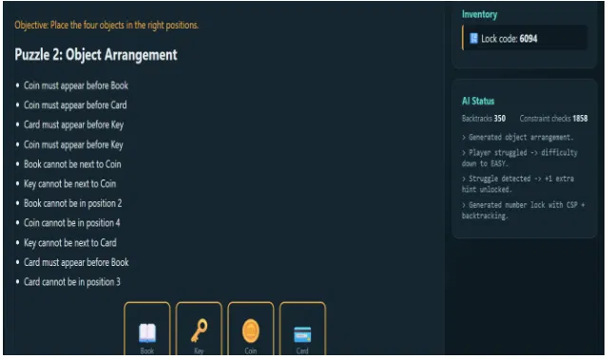
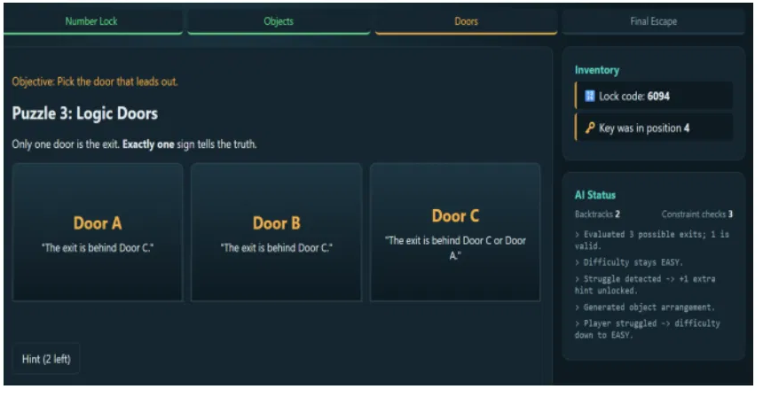
Output 2: Objects and Logic Doors
Puzzle 2: Object Arrangement
Order rules (before) and adjacency rules (not next to)
Lock code 6094 now in inventory
Status: 350 backtracks, 1858 checks
Puzzle 3: Logic Doors
Three signs, exactly one tells the truth
AI evaluated 3 possible exits; 1 is valid
Hint button (2 left) helps the player

Slide 9
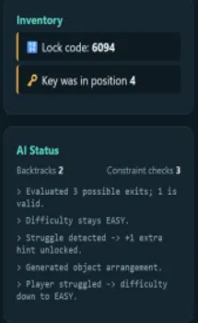
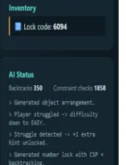
Output 3: AI Status and Adaptive Difficulty
Inventory
Collected results (lock code, key position) carry into the final escape
AI Status log
Shows each step: generated puzzle, struggle detected, difficulty down to EASY
after Puzzle 2
Adaptive help
Struggle detected gives +1 extra hint and an easier next puzzle
after Puzzle 3

Slide 10
Conclusion & Future Scope
What we achieved
Future scope
Four AI-generated puzzles: Number Lock, Objects, Doors and Final Escape
Puzzles built with CSP and backtracking, so every game is different
Live AI Status panel: backtracks and constraint checks
Adaptive difficulty and extra hints when the player struggles
Inventory links earlier answers to the final escape
More puzzle types (grids, sequences, ciphers)
Difficulty levels chosen by the player
Smarter struggle detection using time and wrong attempts
Leaderboard and score tracking
Multiplayer / timed team mode
Benchmark solver speed on harder puzzles
Thank you

